Slide 1
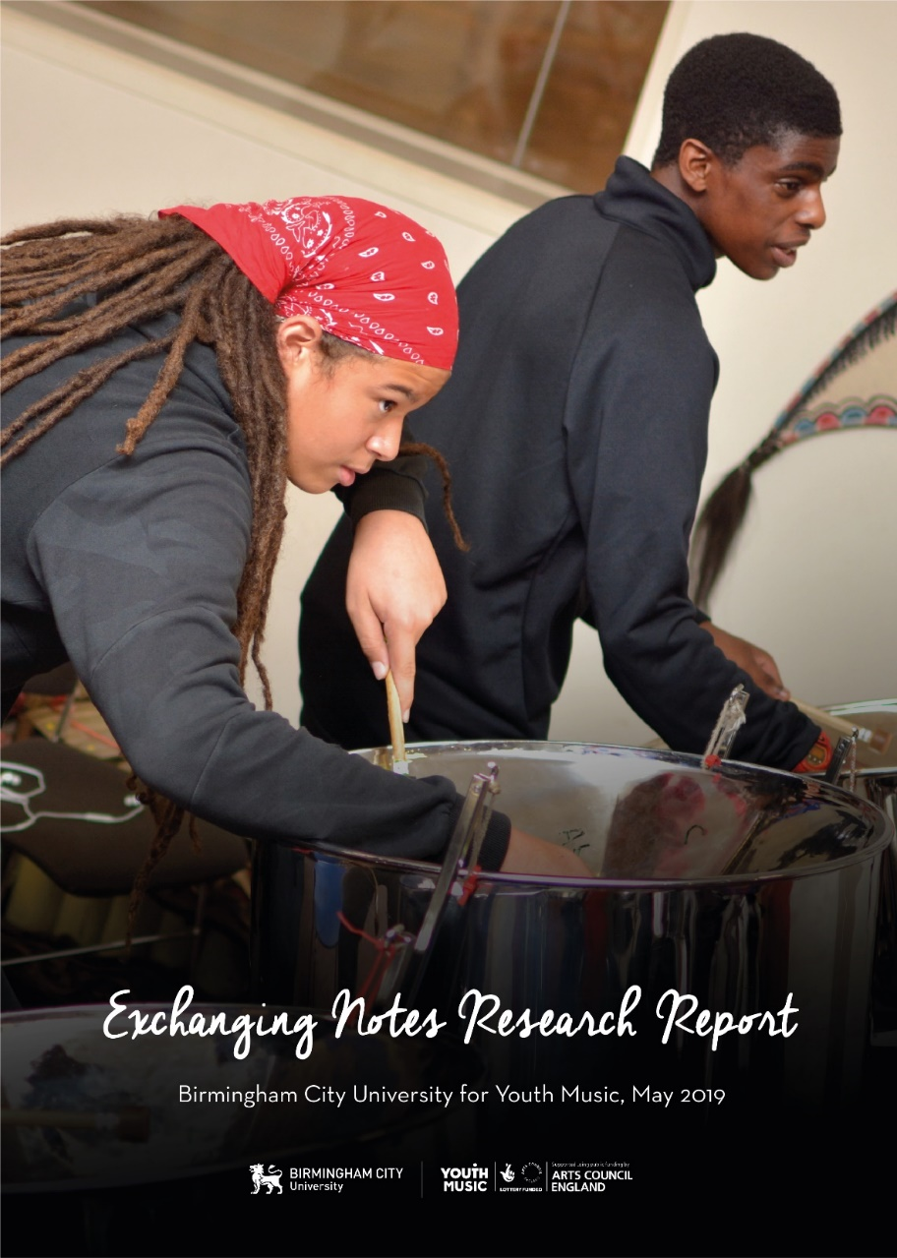
Exchanging Notes: Equality and Inclusion.
Dr Victoria Kinsella
Email: victoria.kinsella@bcu.ac.uk
Twitter: @drtorikinsella
Senior Research Fellow Birmingham City University

Slide 2
Exchanging Notes
‘The best model for Music Education includes a combination of classroom teaching, instrumental and vocal music tuition and input from professional musicians. Partnership between organisations is the key to success.’ (DfE & DCMS, 2011 p.13)
In response Exchanging Notes was a 4 year action research programme aimed to ensure that young musicians at risk of low attainment, disengagement or educational exclusion achieve the best musical, educational and wider outcomes through participation in a pioneering music education project; and to develop new models of effective partnership working between schools and out-of-school music providers.

Slide 3
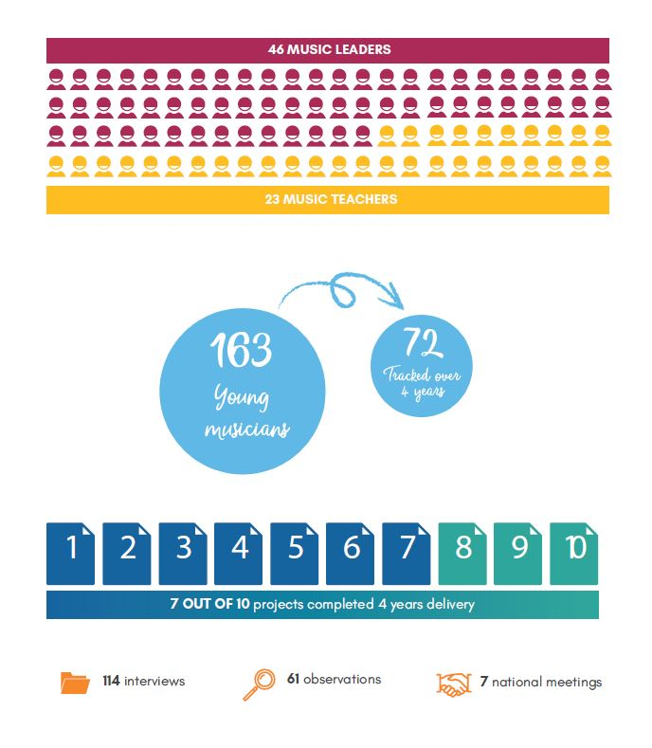

Slide 4
Young people at risk of exclusion?
Profound and Multiple Learning Difficulties (PMLD) and having Education, Health and Care Plans (EHC)
Looked after young musicians
Young musicians learning in inclusion units
Young musicians from areas of significant economic deprivation
Young musicians with challenging home circumstances.

Slide 5
The impact of hidden exclusions
There are concerns that the EBacc has increased anxiety and stress among young people, and that schools which are oversubscribed pick the best pupils and select out those likely to achieve lower grades (Leckie & Goldstein, 2017).
An Education Select Committee report in July 2018 voiced “concerns about the over-exclusion of pupils” and “an alarming increase in ‘hidden’ exclusions’ because ‘schools are struggling to support pupils … which is then putting pressure on alternative providers”.
“Because we are in the inclusion unit we don’t get to do music that much.” (Young musician)

Slide 6
Broader perceptions of success, progress and progression: The Baggage we come with!
In schools, it is attainment and progress that are the key indicators of successful outcomes.
For the music organisations, however, there was a different imperative, what mattered was engagement. Achieving engagement was something that needed to be worked at, and so music organisations were less concerned with delivery, assessment, and progress, and more with the individual children and young people being involved in what was going on.

Slide 7
Broader perceptions of success, progress and progression: The Baggage we come with!
I guess, because of the rigidity of a system which is so based around structure and evaluation and valuing through a marker system, there actually is a freedom that comes with young musicians with being part of something which is not based around that kind of system. Oh, you got a C, you got an A, you got a merit, and you got a distinction. You know, it becomes much more about a personalised journey and the value that comes from the self and, therefore, it becomes about you. (Teacher)

Slide 8
Measures of Success
• Uptake of GCSE music
• Joining outside of school music activities
• Engaging in school and wider school activities
• Progression on an instrument
• Music qualifications, including Arts Award
• The social impact of music making
• School attainment

Slide 9
The school has never doubted that it has been having a positive impact, which is not always measurable in the ways that we’re collecting data, necessarily. Maybe their attendance was always okay, but they were just very different around school and things like that. Or maybe their grades were okay but there were other issues that we encountered with them. So, I don’t think necessarily the tangible impact that we see in the life of the student, necessarily reflects in the data that we collect but it is recognised, and it is seen, and it’s noted that the students do spend far less time in places like PAC [exclusion in school] and exclusion meetings and things like that. (Music leader)
And the issue was that none of them had progressed enough to access the new spec of GCSE music. (Music leader)
Usually in school we very much have certain skills we need to cover, get certain grades and it is very much target driven. Whereas this is far more looking at the individual needs of the children’ (Teacher)

Slide 10
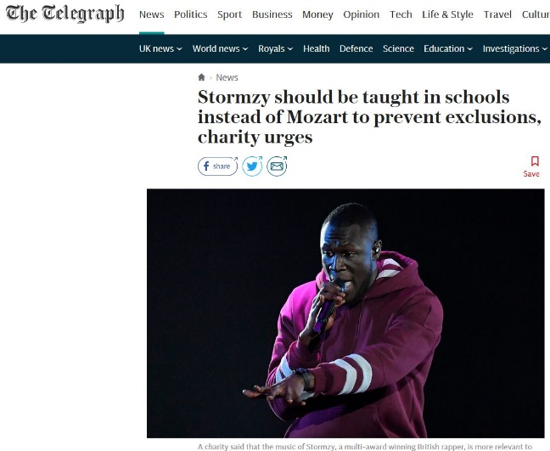
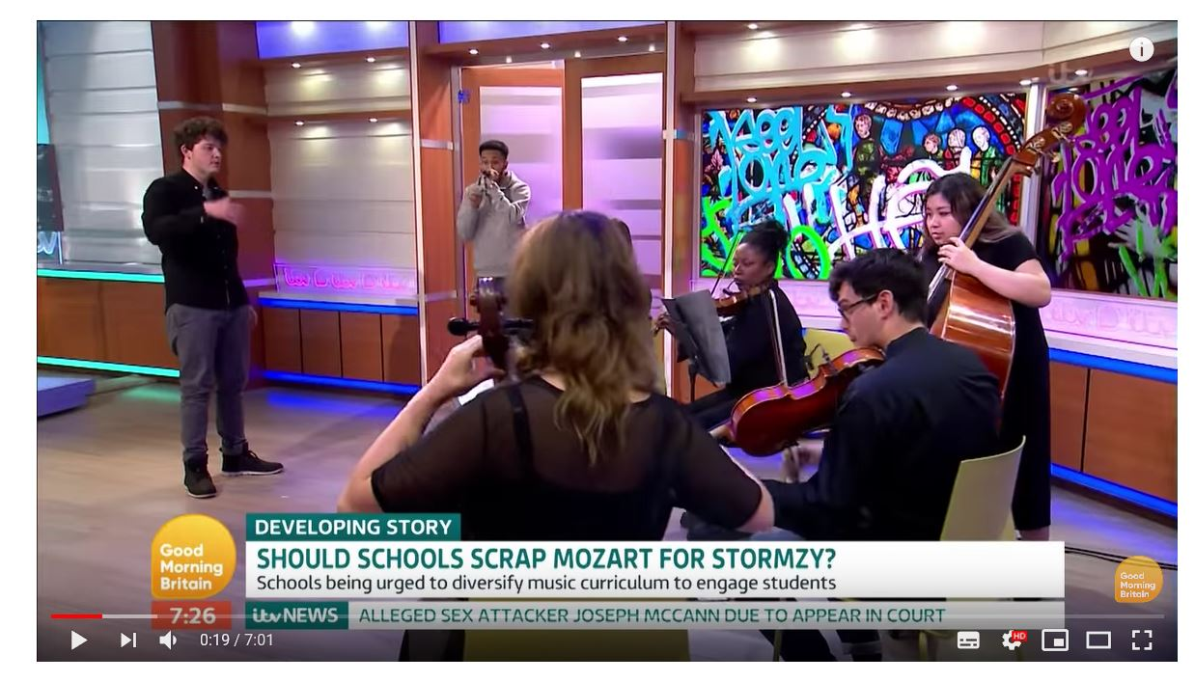
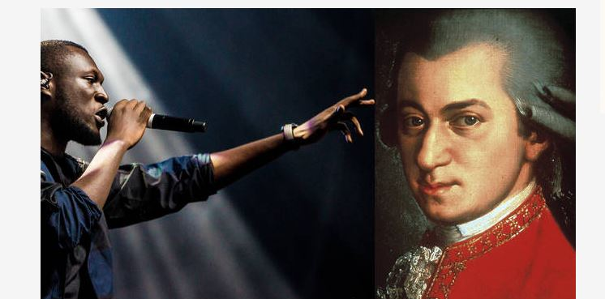
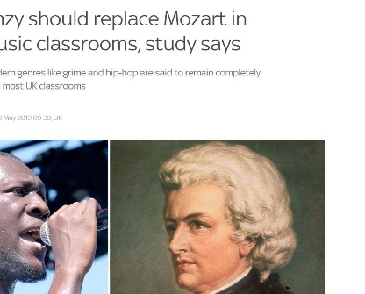

Slide 11
As Spruce and Matthews (2012: 119) argue:
… the musical values inherent in western art music continue to be promoted as self-evidently defining ‘good’ music and consequently ‘high status’ musical knowledge, resulting in the alienation of many pupils from the formal curriculum … despite the introduction into the curriculum of music from other traditions and cultures to try to address such alienation – the way in which these musics are typically presented sustains and reinforces rather than counters the western art music rooted conception of high status music knowledge which tends to be at the centre of the music curriculum.

Slide 12
Appropriateness of the curriculum
Retain enough flexibility to allow participation and engagement alongside learning and progress
Draw on young people’s existing musical tastes to ignite a passion for classroom music, and enable them to have ownership over their musical journeys
Be designed to standalone, i.e. are not written solely as a pathway into Key Stage 4
Exploit the aspects of making music that promote social and emotional wellbeing
Be future-facing – helping to develop the skills that young people will need for a future music industry for those who wish to pursue that route.

Slide 13
Purpose of the Curriculum
KS3 needs rethinking in terms of completeness both in itself, and as preparation for GCSE.
The KS3 curriculum is often thematic, project or topic based, and predicated on sequential modes of delivery (Fautley, 2016a; b; Fautley et al., 2018; Anderson, 2019).
The Exchanging Notes work has shown that where schools come into contact with different musical modalities, fresh thinking can produce novel curriculum ideas.

Slide 14
Young musician-centred
Music-making is placed within the wider context of the young musician's life, with recognition of the young musician's existing musical identity
Young musicians experience equality of engagement: no participant is discriminated against
The young musician's performance and technique are monitored, and achievements are celebrated and valued
Feedback on young musician's practice is given, with next steps for improvement made clear (though not necessarily through spoken instruction). Where possible the pathway for improvement is identified by the young musician and their peers
Achievement and excellence are measured in terms of personal progress and a comparison to others is only made where appropriate
The music leader and/or project staff identify any needs for additional pastoral or other support, and seek to provide or signpost to this as appropriate

Slide 15
Closer multi-agency working to improve outcomes for young musicians
Social workers
Carers
Independent reviewing officers
Music therapists
SENCOs
School pastoral staff
Learning support teams
Medical professionals

Slide 16
Creating a non-hegemonic alternative to music education.
I think it’s been about demystifying the specialism of music and demystifying what inclusion and partnership means. It’s actually about acknowledging what people are already doing, and how our children communicate and express themselves. (Teacher)
The projects had to find ways to explore new approaches that were democratic, collaborative and constructively critical.
Offering a way for thinking differently.
Challenging traditional understandings of the nature of musical knowing.
A wider understanding of what constitutes musical knowledge, including the social, emotional, wellbeing and communicative aspects of learning too.

