Slide 1
Composing through the ages
Building connections from EYFS to GCSE

Slide 2
The 4 stages of development
EYFS & KS1
KS2
KS3
Y10
Y11
Free exploration using gained knowledge
Introduce constructs & simple musical devices
More complex musical devices
Free exploration

Slide 3
The NC
KS1: Students experiment with, create, select and combine sounds using the interrelated dimensions of music.
KS2: Students improvise and compose music for a range of purposes using the interrelated dimensions of music.
KS3: improvise and compose; and extend and develop musical ideas by drawing on a range of musical structures, styles, genres and traditions
KS4: make use of musical elements, techniques and resources to create and develop musical ideas with technical control and coherence; freely as the composer chooses, and responding to a brief or commission supplied by others.
compose music that develops musical ideas, uses conventions, and explores the potential of musical structures and resources
experiment
select
combine
review
refine

Slide 4
Ks2 composing ideas
Free soundscapes
Building musical knowledge
Students create:
incidental music for a school play
music to accompany a poem or section of a book
music for a themed assembly
Explore appropriate instruments and sounds
Explore the interrelated dimensions of music – pitch, dynamics, pace, silence, texture, timbre, duration
students incorporate melodic devices based on their musical learning
Select and combine musical ideas to satisfy the purpose
Introduce students to the concepts of:
Drone Pedal note Ostinato Pentatonic scales
Binary and Ternary Form Simple rhythmic patterns
These devices can be used to create accompaniments to:
Folk songs/Pentatonic songs
Amazing Grace, Chinese Boat Song
Musical knowledge work from KS1 can be extended to include Samba composition – use common words – DT terms, Geographical & Historical concepts, use MFL learning.
Use words/phrases to create rhythmic patterns (introduce rhythmic notation)
Layer patterns and students ‘conduct’ their own compositions
How can these activities support the development of literacy and numeracy?

Slide 5
Ks3 composing ideas
Free soundscapes
Building musical knowledge
Students create:
incidental music for a school play
music to accompany a poem or section of a book
music for a themed assembly
protest song
Introduce students to the concepts of:
Chord progressions (Primary Chords + vi)
Melodic hooks and riffs
Repetition and Sequence
Major/Minor Scales
Complex time signatures
Rondo, Verse, Chorus, Intro & Outro
Introduce the use of technology:
DAW packages to create music using real-time input
Performance opportunities:
Teach the concepts above through performance activities
Composition tasks:
Create small tasks that enable students to explore and combine musical devices in each lesson.
Create chord progression – then an accompanying bass riff
Create a melodic line and then hook as a call and response concept
Create a chord progression, choose 3-5 notes from the tone centre, create a motif that plays over the chord progression
Explore melodic variations
Students are:
Exploring appropriate instruments and sounds
Explore the interrelated dimensions of music – pitch, dynamics, pace, silence, texture, timbre, duration
students incorporate melodic devices based on their musical learning
Select and combine musical ideas to satisfy the purpose

Slide 6
Example for Film Music Teaching and learning
The Leitmotif
Texture/Timbre/sonority
Superman (rhythm)
Hedwig’s Theme (chromaticisms)
StarWars title theme
Imperial March (Fourth down *villain)
Raiders March (Fourth up *hero)
Dual of Fates
2 contrasting melodic ostinatos that develop from each other
Articulation – legato, staccato
Duration – introduction of dotted rhythms, 1/8 and 1/16th notes
Batman
Low pitched ascending brass ostinato 4 notes
High pitched descending bell scale

Slide 7
Student outcome
With thanks to icancompose.com and Soundtrap

Slide 8
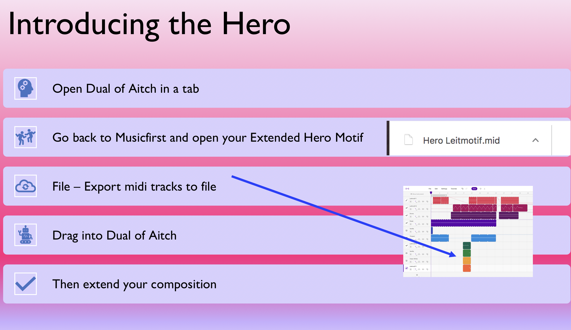
Extending and developing
SG as example

Slide 9
Ks4 composing ideas
Free soundscapes
Building musical knowledge
Students create:
incidental music for a school performance
music to accompany a poem or section of a book
music for a themed assembly
protest song/ballad
movie trailer
Introduce students to the concepts of:
Chord progressions (Secondary & Extended chords)
Modulation
Major/Minor/Blues Scales and Modes
Complex time signatures
More complex song forms – bridge/middle 8
Introduce the use of technology:
DAW packages to create music using real-time input
Performance opportunities:
Teach the concepts above through performance activities

Slide 10
Starting to write songs
Composition tasks:
Create small tasks that enable students to explore and combine musical devices in each lesson.
Create chord progression – then an accompanying bass riff
Create a melodic line and then hook as a call and response concept
Create a chord progression, choose 3-5 notes from the tone centre, create a motif that plays over the chord progression
Explore melodic variations
Bassline/Chords/Rhythm
Starting out a song

Slide 11
Film Music Teaching and Learning from KS3
Scales – Major, Minor, Diminished Scales – using to develop melodic motifs
Chords – When and how to use them in texturally as accents
Pedal Note & Drone – How to develop sonority and anticipation – dissonance
Melody – doubling in octaves, fifths, thirds and minor thirds
Silence – less is more
JL Mother Trailer composition
EDUQAS brief - haunted house

Slide 12
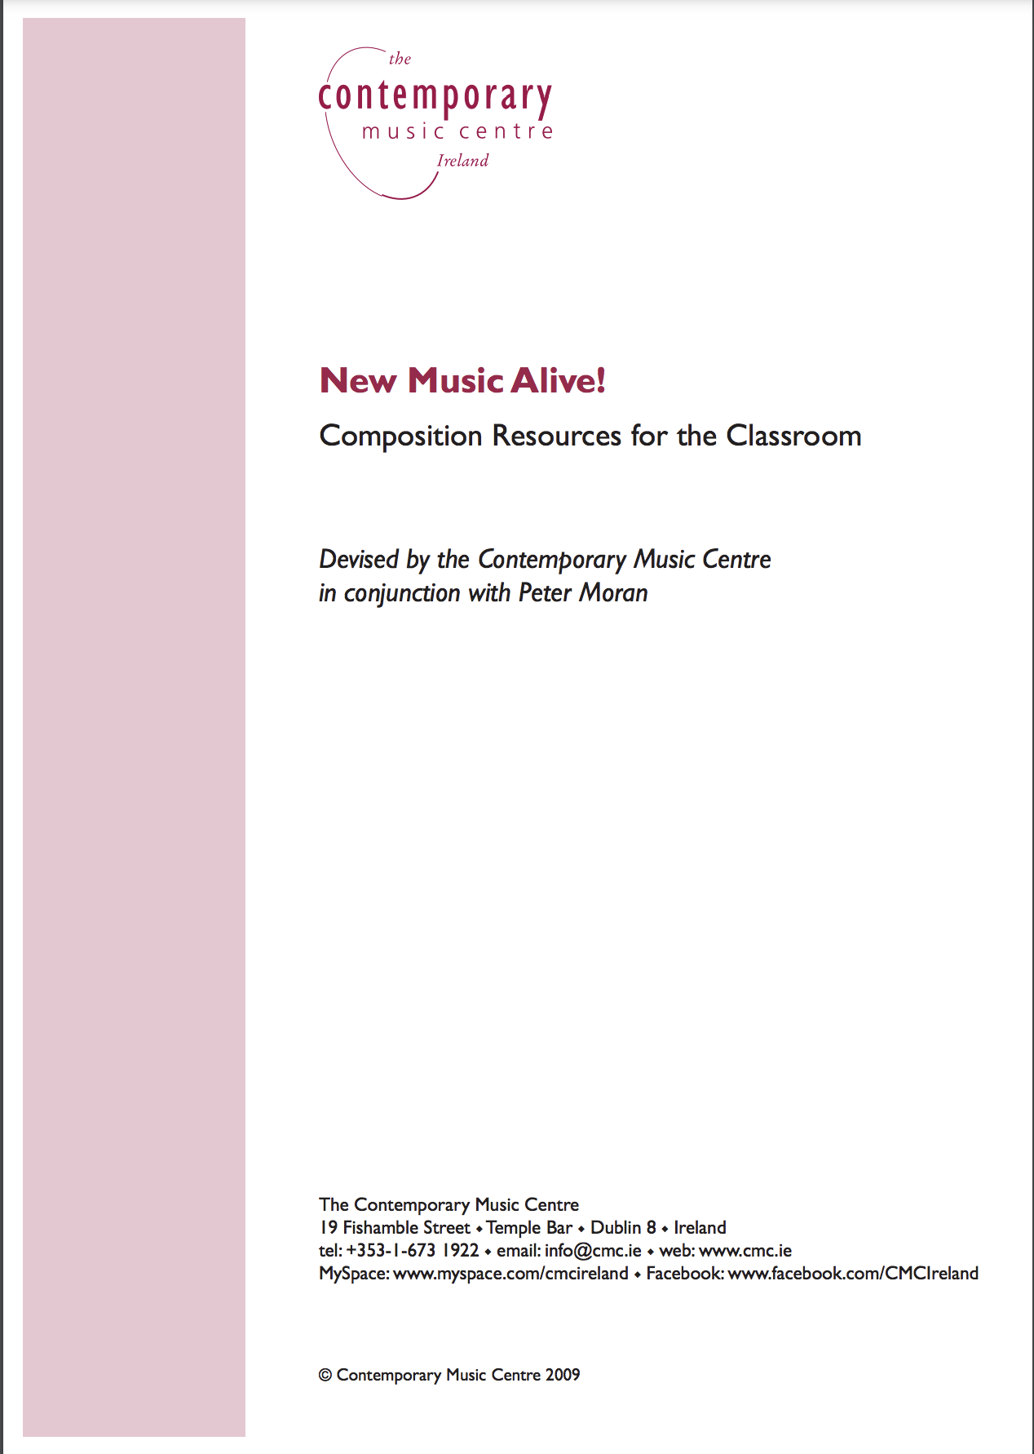
Resources
EYFS/KS1
https://www.bbc.co.uk/teach/bring-the-noise/composing-melodies/zkf78xs
https://www.cmc.ie/sites/default/files/inline-media/new_music_alive_complete.pdf

Slide 13
references
Assessment of Composing at Key Stages 3 and 4 in English Secondary Schools. Fautley, M. & Savage, J. ABRSM, 2008
Composing and the National Curriculum. Stafford, L. Primary Music Magazine 3.1 February 2019
Teaching Composition: Challenging the stereotypes and myths. Devaney, K. Primary Music Magazine 3.1 February 2019
Bringing Composing into schools. Moran, P. https://journalofmusic.com/focus/bringing-composing-schools

