Slide 1
How does technology affects the composing process?

Slide 2
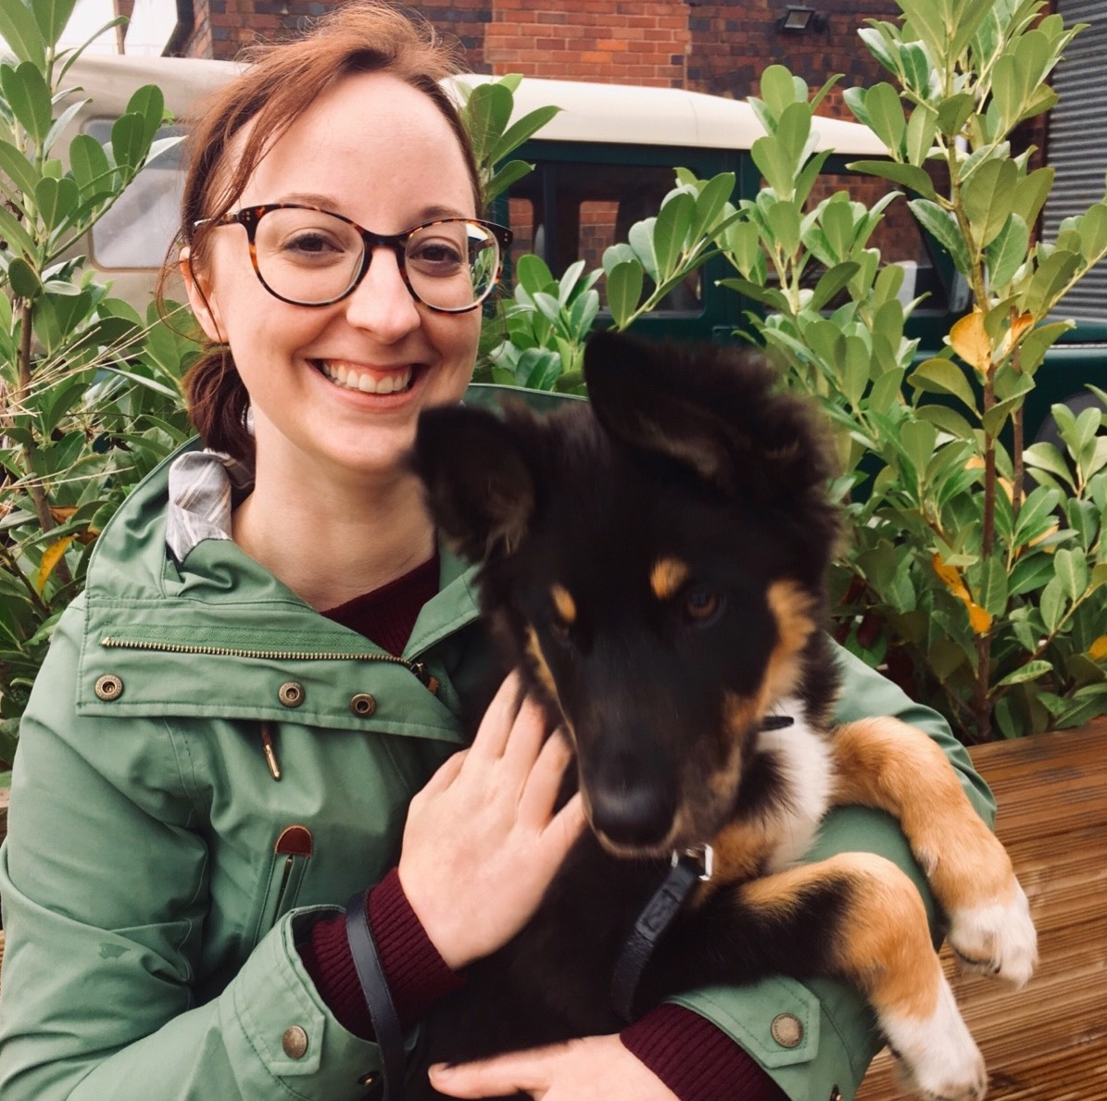
Hello!
Dr Kirsty Devaney
Composer, Research and Music Educator
Research Assistant at BCU
Twitter: @KirstyDevaney

Slide 3
Disclaimer!

Slide 4
?
?
?
?
?
?
?
?

Slide 5
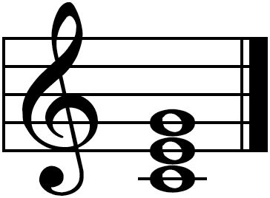
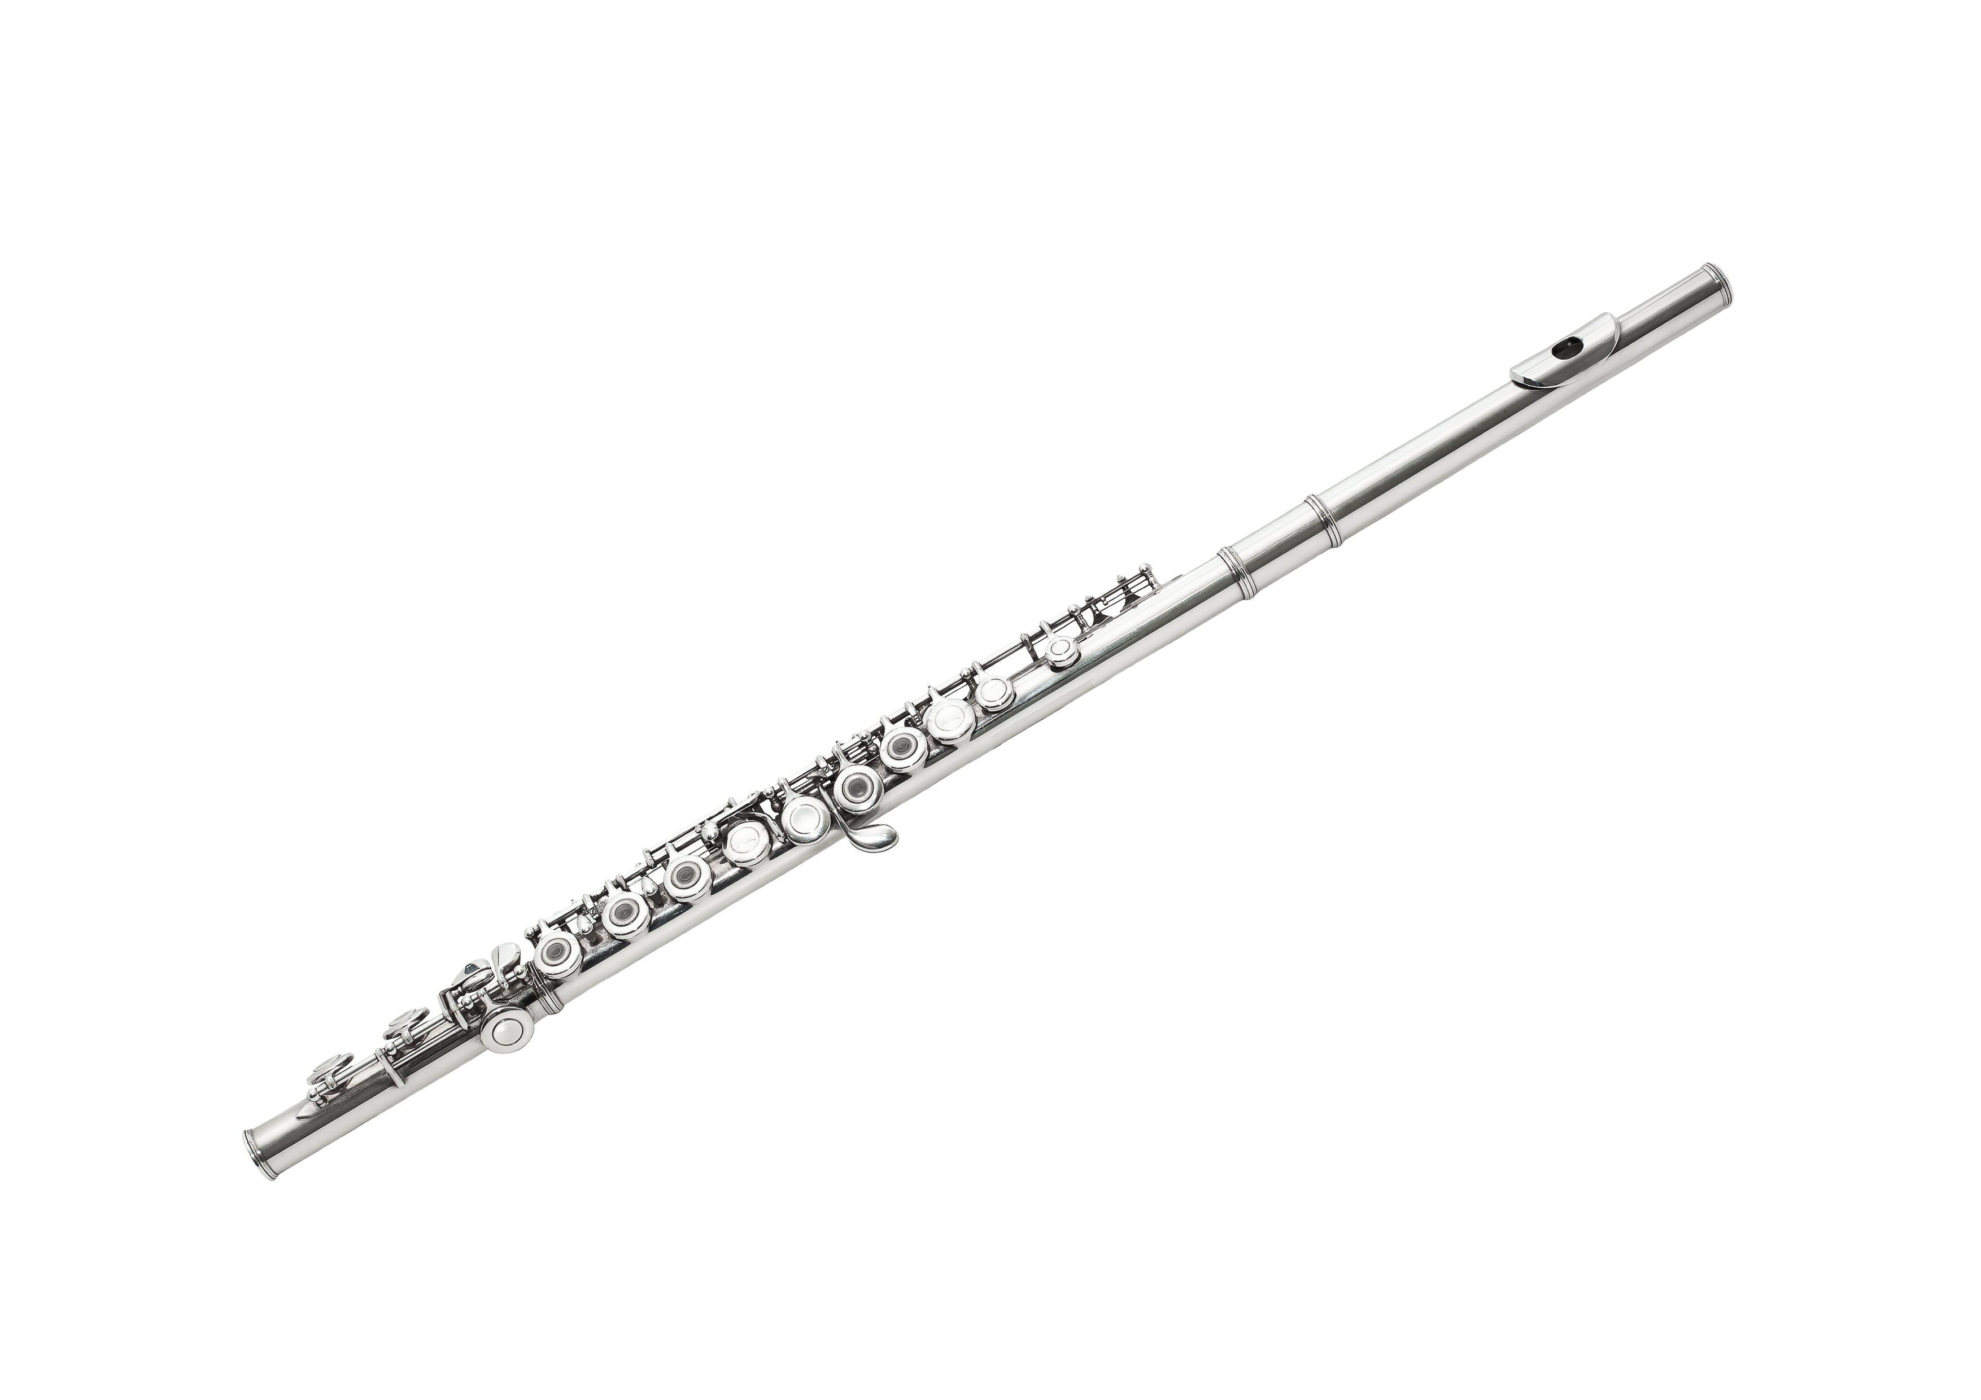
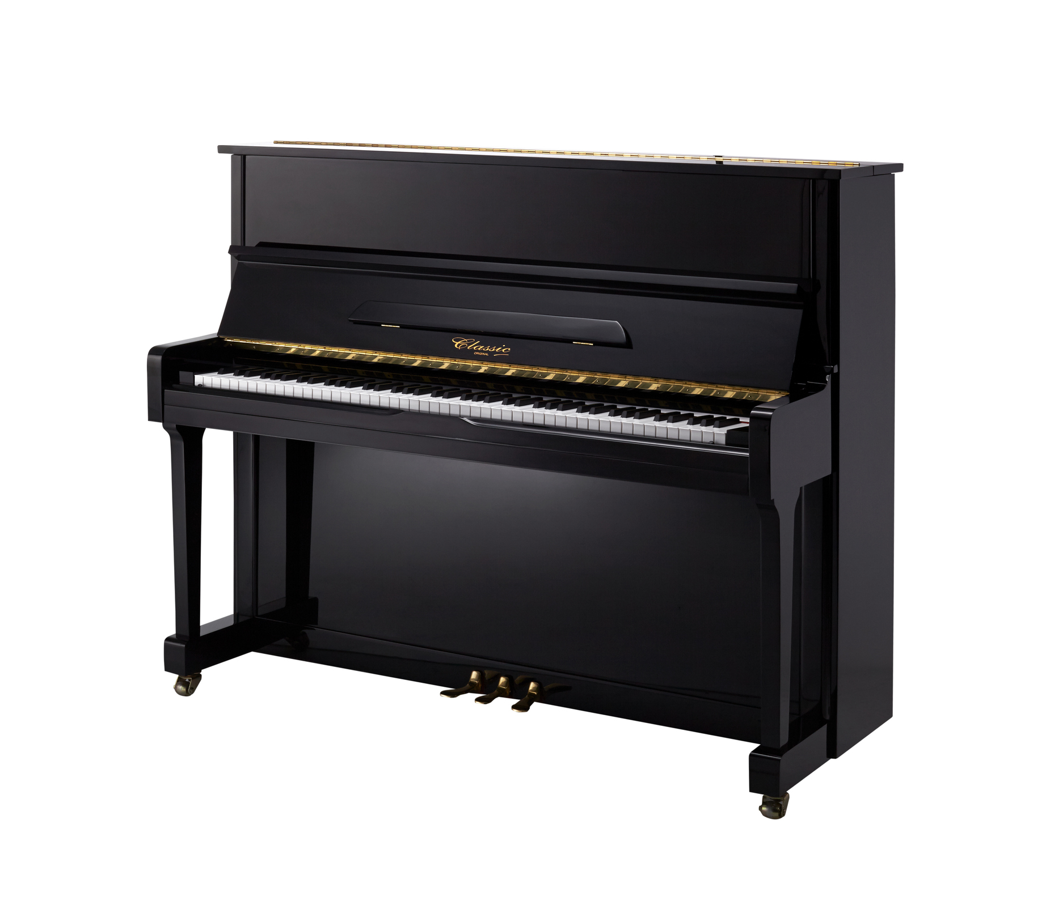
Notes:
I want to talk about one example in particular which, although is not a piece of electronic technology, it is a form of technology and a tool to compose
When I went to uni, I did not have access to a piano in my room (and there were very few practice rooms unless you were willing to battle the performers, and get up at 6am in the morning, which I was not!).
I did however, have my flute.
Now the piano has often been seen as a link to composing, with composers needing to have high level piano skills (something I do not!), I was, however pretty good on the flute. Therefore, I started to compose using my flute instead of at the piano for the first time. This has had a lasting impact on how I go about composing and how I think about harmony, line, melody and shape. Instead of thinking in terms of ‘chords’ I conceptualism harmony by thinking in terms of interval – maybe because the flute can not play chords (easy anyway)
Why does this matter?

Slide 6
Cultural reproduction (Giroux)
TEACHER: “My degree is in music technology, so that's probably why I come from that angle”
Technology?
Technology?

Slide 7
Composing for All
Inclusive & ‘egalitarian’ (Folkestad et al. 1998)
Students without formal instrumental training to engage in composing (Folkestad et al. 1998; Nilsson and Folkestad 2005; Reynolds 2005; Kardos 2012).
‘Real world’ (Wise et al. 2011),
‘Culturally relevant’ (Gall and Breeze 2005).

Slide 8
PhD - How Composing Assessment in English Secondary Examinations Affect Teaching and Learning Practices
2 online surveys for upper secondary music teachers
Telephone interviews
5 case study schools
Interviews with teachers and students
Interviews with 5 composer-educators

Slide 9
How important is technology at KS4 for composing?
“at the centre”
“fundamental”
“essential”

Slide 10
Technology as a shortcut
Teacher: Oh yeah I mean it’s quicker to compose. You know they can cut and paste sections which are minimalism [laugh]…obvious shortcut
Teacher: It’s instant, you don’t have to you write things out, you can put it straight in there and if you don’t like it you can delete it and try something else
Teacher: Everybody that has done it on Sibelius can just press print

Slide 11
Pressure to pass
Teacher: We’ve got to get them the best marks that we can because otherwise it reflects on us as teachers
Teacher: Personally [we] don’t get a massive timeframe really when it comes down to it… So I think that [technology] really helps with the time pressure as well
Teacher: We’ve seen a big increase in the composition marks. [...] I would say I’m almost completely reliant on technology.

Slide 12
An ‘enabler’
Teacher: We’ve got a lots of low ability students so they, they can’t play it on the piano to see what it sounds like, so being able to hear Sibelius is really helpful
Teacher: …technology can be quite an enabler

Slide 13
What impression is it giving of composing and of how composers work?
Is it always ‘real world’ (Wise et al. 2011), and ‘culturally relevant’ (Gall and Breeze 2005).
“You know they can cut and paste sections which are minimalism”

Slide 14
Midi Sounds
“Regimented, and electronic”
“Doesn’t really sound like music”
“Horrible”
“Doesn’t sound very good”
“Fake”

Slide 15
Waiting for that “wow factor”
Student: I just find it really irritating because I want, because I have it in my head like and I want it to sound amazing but then you listen to it on Sibelius and you’re like oh my God, it’s like awful [laugh]…right now I don’t like my composition.
Student: I think the problem is like you’re listening to your piece and it sounds okay but like it’s not got that ‘wow factor’ to it.

Slide 16
‘Sibelius Composers”
Composer: With the rise of music technology and people being able to put a whole Symphony Orchestra on Sibelius or writes a film score that has an orchestra of 100 people

Slide 17
Importance of live sound
Composer: Having live acoustic instruments …for people to play and to write for is really important
Composer: Having their music performed live…It’s very important. And once it’s happened once then that’s when you get the “buzz”

Slide 18
Keeping it Practical
Composer: Write something for instruments that they know will be up to be heard by their peers
Composer: …write something for three instruments that way you can actually hear the music being played and you can talk to the musicians
Composer: Rather than write huge orchestral scores on Sibelius which are just living in an unrealistic world…
Composer: [if] it's not going to get heard what's the point?”

Slide 19
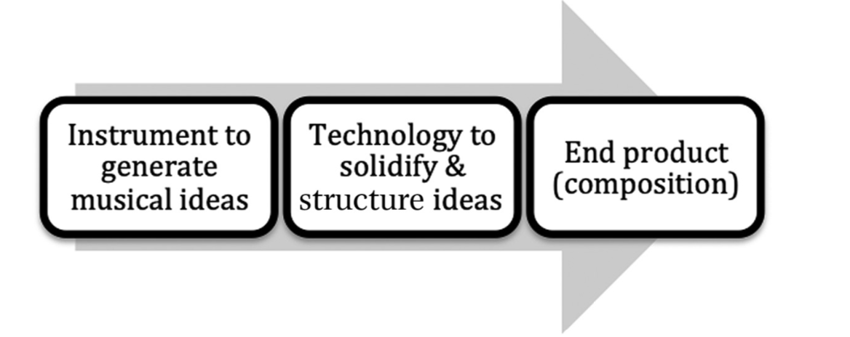
How and when to use technology?

Slide 20
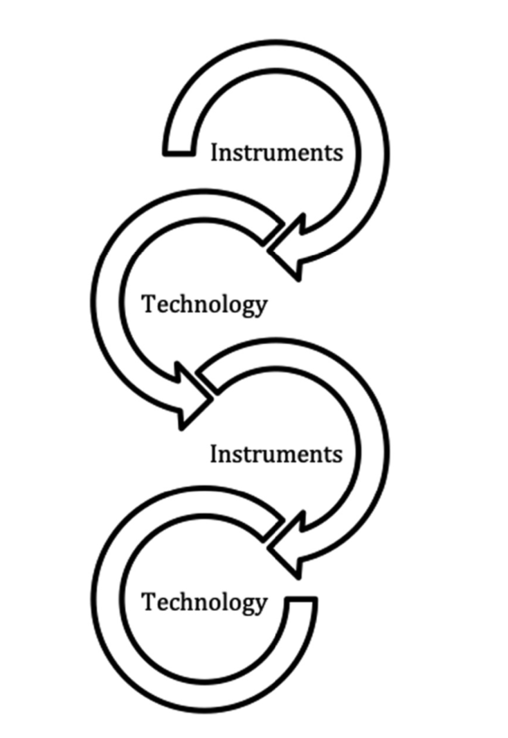

Slide 21
Some points to ponder
How do you encourage students to use technology for composing in KS4 and KS5 lessons?
Are there some assumptions about how students should start to compose?
Are there possibilities for learning from live performances/rehearsals?

Slide 22
Thank you!
Dr Kirsty Devaney
Composer, Research and Music Educator
Kirsty.devaney@bcu.ac.uk
@KirstyDevaney

