Slide 1

Composing with Tech
Professor Martin Fautley
23 February 2021

Slide 2
Some slides from LIC sessions last year

Slide 3


Composing with Technology,
Jennings (2007)
Jennings, K. (2007). Composing with graphical technologies: representations, manipulations and affordances. Music education with digital technology. J. Finney and P. Burnard. London, Continuum: 76-95. p76-77

Slide 4
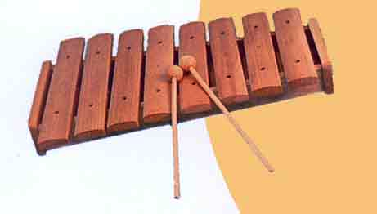
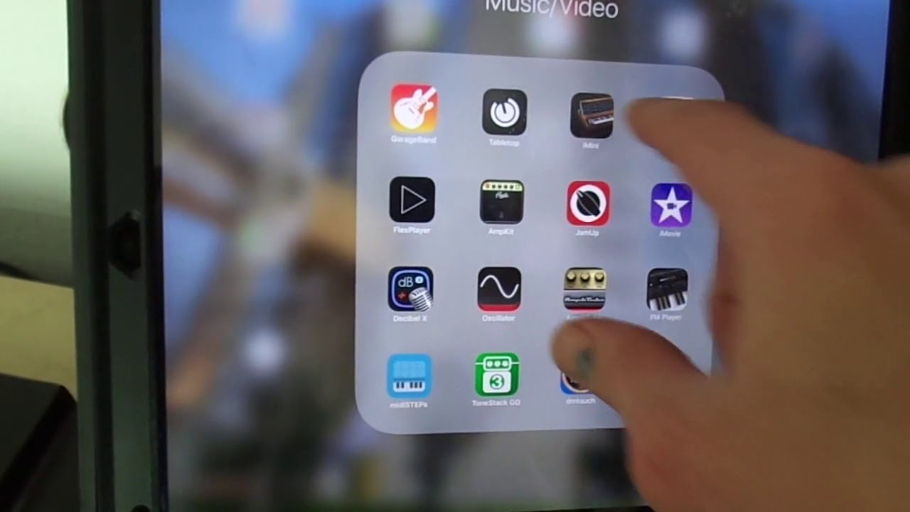
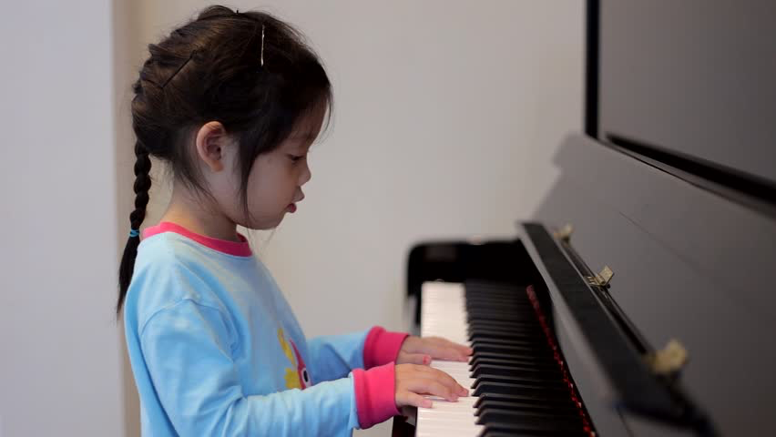
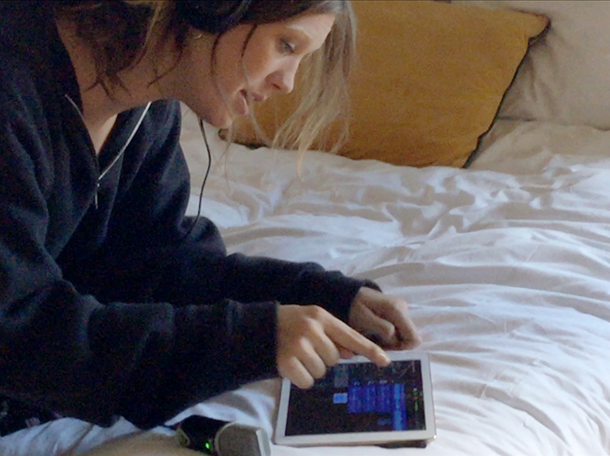
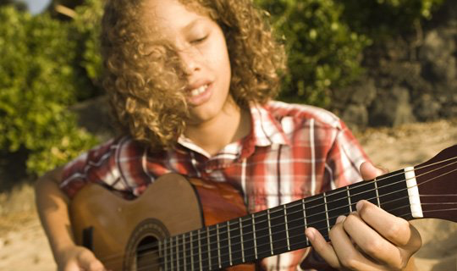

Revision: Affordances

Slide 5
Savage (2005)
Our primary focus should be on seeking creative approaches to the use of ICT in music education that develop musical dimensions within the curriculum in ways that would be impossible without the technology. By using carefully chosen technologies within the music curriculum in this way, pupils’ musical experiences can be more challenging, varied and educationally richer than those possible within a music curriculum devoid of ICT.
Savage, J. (2005). "Working towards a theory for music technologies in the classroom: how pupils engage with and organise sounds with new technologies." British Journal of Music Education 22(2): 167-180. p179

Slide 6
New teaching and learning questions for this year
What does teaching and learning in music entail, and has/why has the covid situation changed this?
What does the ongoing covid situation mean for teaching and learning composing in music?
What affordances does tech offer those without access to traditional instruments?
What do I want the children and young people to learn, what do I want them to do, and how can I operationalise this using tech?

Slide 7
Practical questions for today
How can I organise my learners to be able to compose during the current situation?
What can I take from today’s session that will be of immediate practical benefit?
What can I take from today’s session that will be of possible use in the long term?
What will work with my kids, in my school, right now?

