Slide 1
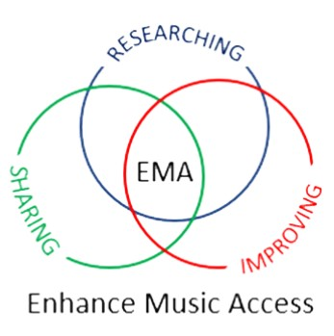
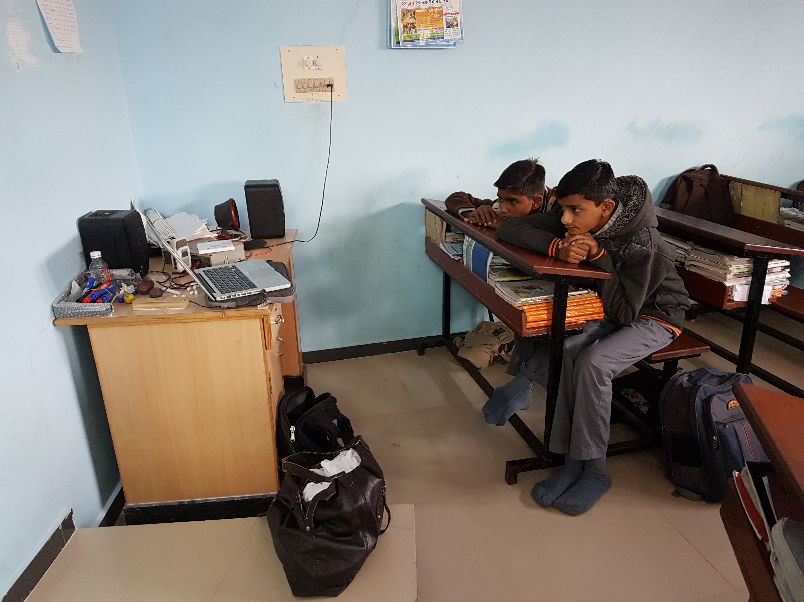
Enhancing Music Access for all pupils
Dr. Motje Wolf
De Montfort University Leicester

Slide 2
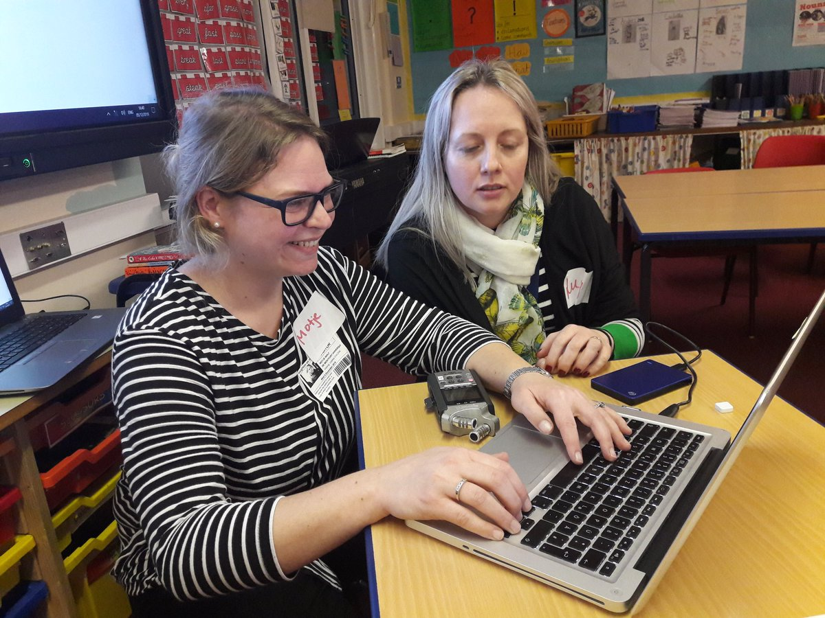
Content
Why to compose with sounds?
How to compose with sounds?
Resources
Homework!

Slide 3
Enhancing Music Access
Aims at making music teaching more accessible for pupils (and also for those teachers who have to teach music, but haven't studied it).
Researching – Improving - Sharing: teacher practice

Slide 4
Why are we doing this?
Many benefits for Music making:
Musical
Psychological
Personal
Emotional
Social
Physical
As teachers we need to ensure that all our students have access to these benefits of music in our classrooms.

Slide 5
Problems
Develop cultural capital for students (Bourdieu 1977)
Disrupt the same old… (Habermas 1987)

Slide 6
What we do
Offer free CPD to schools and invite to join Community of Practice
Provide knowledge to make music with pupils on a level playing field...
leading to music for social inclusion.
Follow up research: observations and interviews
or in your case: self-evaluation and interview

Slide 7
Why sounds?
Engagement in all classes increased
Access increased – level playing field

Slide 8
Teacher voices:
‘It’s just letting them [pupils] to think a bit more that music isn’t always ‘get instruments out and hit things’
teacher reported that with body percussion children ‘are actually given a chance to explore music in a way that they enjoy’
inclusive music education means that ‘everybody can join in and there’s a level playing field’

Slide 9
How?
Research with KS 3 students:
Those whose listening changed, appreciated electroacoustic music more.
Cognitive prototype
For students AND teachers

Slide 10
CPD MODEL
Content/
pedagogic
content
knowledge
Community
Of
Practice
Wolf and Younie (2018):
Cognitive
Prototype
Metacognitive
Knowledge

Slide 11
Listening training
Follow these steps:
Prerequisite: musical properties: pitch, rhythm, duration, layers, texture, …
Listen to the sound
Allow all responses and ask for the source
Listen to the sound again and ask for musical properties of the sound

Slide 12
Resources
www.ears2.dmu.ac.uk
KS3 but useable before and beyond
Learning Environment – Teacher’s Packs – Software
Free of charge

Slide 13
Homework
Work through the Real World Sounds – beginner module on EARS 2.
Compose a Sonic Postcard

Slide 14
Thank you!
Dr. Motje Wolf: mwolf@dmu.ac.uk

Slide 15
Publications
Wolf, M. (2013) The Appreciation of Electroacoustic Music – The Prototype of the pedagogical ElectroAcoustic Resource Site. In: Organised Sound, 18 (2).
Wolf, M. and Younie, S. (2018) Overcoming barriers: towards a framework for Continuing Professional Development to foster teaching sound-based music. In: Journal of Music, Technology and Education, Vol 11.
Wolf, M. and Younie, S. (2019) The development of an inclusive model to construct teacher’s professional knowledge: pedagogic content knowledge for sound-based music as a new subject area. In: Organised Sound, 24(3).

