Slide 1
How to set up and run a composition club
_______________
Rachel Shapey, I Can Compose

Slide 2
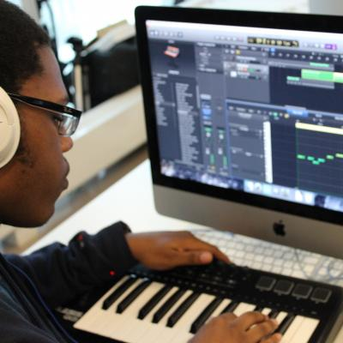
How are you catering for the musically curious students in your school?
________________________

Slide 3
4 features of a successful composition club:
_______________________
Organised
Relevant
Enjoyable
Safe

Slide 4

1. Be organised
_________________
Establish a core group.
Set regular composition tasks (more on this later)
Plan ahead - get dates in the diary

Slide 5
1. Be organised
_________________
Dedicated online area for club members
Establish a routine
Get older students to assist

Slide 6
2. Make it relevant
__________________
What’s the point?
Distinction between classroom lessons and the club
Added value

Slide 7
2. Make it relevant
____________________
Use real-world composing tasks = engaging & purpose-driven
Real-world composing task examples:
Compose a Year 6 leavers’ song for a feeder primary schools’ leavers’ assembly
Compose a calm piano piece for Year 7 walking into assembly
Compose a song for the Battle of the Bands competition

Slide 8

3. Make sure it’s enjoyable!
Offer opportunities that may not be possible in lesson time
Cake rota!
Seek out the positive - involve tutors/HOYs

Slide 9

4. Do students feel safe?
_______________________
How can we promote a positive, creative sharing atmosphere?
Do students feel safe and confident that their ideas will be valued?
Use a sharing board in the classroom
Schedule composition-sharing sessions

Slide 10

Stay in touch:
Blog post: www.icancompose.com/blog
Email: rachel@icancompose.com
@i_can_compose

Slide 11
Creative task:
Consider your musically curious students. Imagine you are going to set up a composition club (hopefully this will become a reality!) - think up 4 real-world composing tasks to set in the club.
What would students need to get started?
How would the composition be realised?
Can we aim to get a bank of real-world composing tasks that we can share?

