Slide 1
ISM Trust resources: Musical Understanding
https://www.ism.org/professional-development/resources/musical-understanding
Focus is on curriculum music: not on other aspects of full music education (ie instrumental learning/ensembles; concerts, shows, residencies, Arts weeks, etc)
Focus is on strategic thinking: curriculum ‘intent’
(ie not details of elements, technology, units of work etc)
Focus is on Musical Understanding as the basis for intent:
20 years before NC introduced
NC itself – all 5 versions
NC authorities guidance: NCC, SCAA, QCA, QCDA, NS
Ofsted

Slide 2
Musical Understanding: a history of development
In the beginning: musical understanding is assumed to be important, but is not clearly defined
Over time:
Explicit statements confirming it is critical
Definitions – in words and musical examples
Identification of progression in learning
Why is Musical Understanding not at the heart of our professional discourse on curriculum music?
1992 hiatus:
Music through musical understanding developed by holistic musical learning
Bits of music through atomised learning: P/C/L+A and elements of music

Slide 3
Musical Understanding: a form of knowledge
Knowledge ‘of’ music
to distinguish it from
Knowledge ‘how to’ music
(ie practical skills of performing, composing, etc)
Knowledge ‘about’ music
(ie theory, musical elements / dimensions, facts about composers, etc)

Slide 4
Musical Understanding: progression pointers
QCDA Exemplification materials
APP (Assessing Pupil Progress):
chart of statements (NB first column is critical)
full guidance notes
Ofsted (‘Wider still and wider’ triennial report):
two sentences for each key stage
reinforce first sentences of the old Levels statements

Slide 5
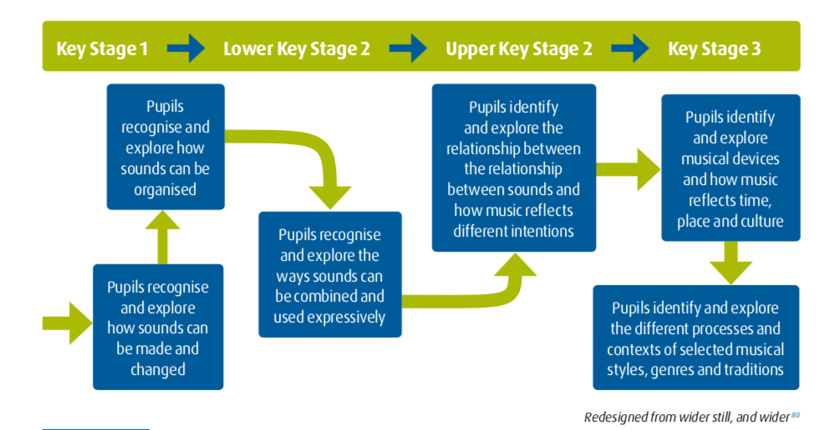
Musical Understanding: progression pointers
‘Another, simpler, model of effective planning for musical progression across phases started with the ‘big idea’ in each National Curriculum attainment level statement. This approach enabled teachers to understand very clearly how pupils’ musical understanding might develop over time’.

Slide 6
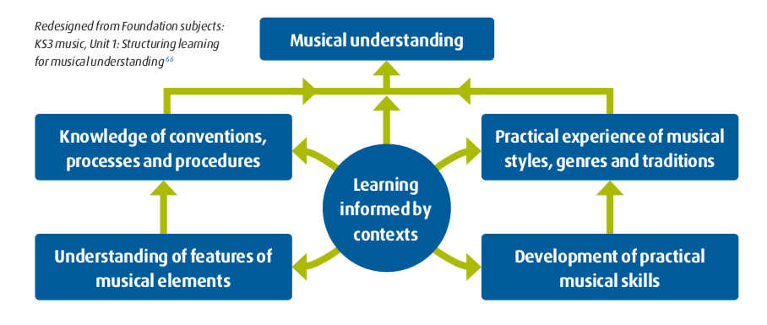
Musical Understanding: the function of composing
1992 Working Group:
‘composing, because of its central importance to the development of musical understanding, should retain a clear identity’

Slide 7
Musical Understanding: the place of composing
Current orthodoxy
Tacked on to the end of a unit (‘we’ve done the context, performed a version, now they can write their own song’)
Proposed alternative approach
What stage of musical understanding have the students reached, and how can creative, composing-centred challenges consolidate / develop this learning?
Patterns: cards with chord sequences/bass riffs/melodic patterns – mix’n’match these, create your own . . .
Devices: make a 30 second intro on 3 instruments using C/Dm/Em/Dm repeat in a slow tempo
Processes: how to write a song: try starting from rhythms, chords, riffs and add melodic line . . . or reverse process

Slide 8
Musical Understanding: consequences for composing
Composing and creative exploration becomes the heart of curriculum learning
Composing outcomes show greater diversity: students respond individually instead of writing music to a formula; and want to to take their creative exploration beyond the classroom

