Slide 1

Doing more with the young composers in your school – in and beyond the classroom
Professor Martin Fautley
18 June 2020

Slide 2
Reports, all published 2019
Social Mobility Commission, 2019
Can Compose Report, 2019
The development of schemes, building on existing initiatives, to recognise and celebrate best practice in schools built upon simple and readily evidenced criteria such as having a specialist music teacher; an attached musician, composer or ensemble; engagement of the local music bodies in supporting progression; weekly timetabling of music within the core curriculum; extra curricula choirs and ensembles; and support for students and parents at points of transition.
Music Commission, 2019

Slide 3
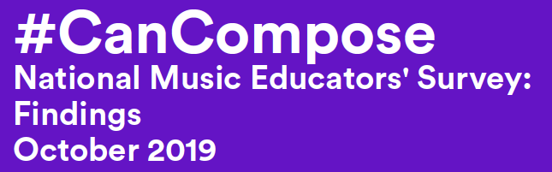
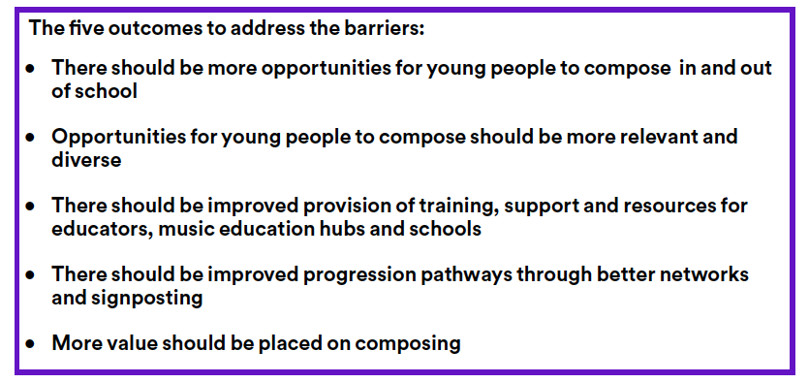

Slide 4
NPME , 2011

Slide 5
Birmingham Music Teachers said:
“Music teachers still feel that in general, they need more support with exams, assessment, moderations, singing and composing”
Fautley et al, 2018

Slide 6
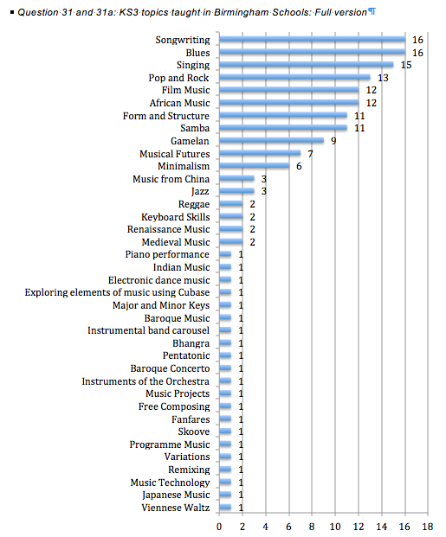
Impossible to tell from these responses where composing is – it could be everywhere!

Slide 8
Progress and Progression I
What does progression look like – and sound like – in young composers?
We are familiar with graded music exams, is this a model?
We are familiar with GCSE/BTec/RSL/A-level music exams, is this a model?

Slide 9
Progress and Progression II
What are the composing words that would go here?

Slide 10
Questions
How (or) do our curricula (KS3 > KS4 > KS5) for composing join up with extra/extended curricular activities?
Is composing integrated or separated within school curricula?
How do we foster progression within our own contexts?
What progression routes are available via our local music hubs?
How do we spot ‘talent’ for composing?
Does style/genre matter?
What support locally/regionally/nationally is available to help with composing?

Slide 11
References
Poster: https://www.bensandbrook.com/sites/default/files/MPR%20skeleton%20strategy%20poster%20A3.pdf
DfE & DCMS (2011) 'The Importance of Music - A National Plan for Music
Education'. London, Department for Education, and Department for Culture, Media, and Sport.
Fautley, M., Kinsella, V. & Whittaker, A. (2018 ) 'Birmingham Music Hub: Secondary School Music Teachers Survey 2018'. Birmingham, Birmingham City University.
Music Commission (2019) 'Retuning our Ambition for Music Learning: Every Child Taking Music Further'. London, The Music Commission.
Social Mobility Commission (2019) 'An unequal playing field: extra-curricular activities, soft skills and social mobility'. Bath, University of Bath.
Sound and Music (2019) 'Can Compose - National Music Educators’ Survey: Findings October 2019'. London, Sound and Music.

Slide 12


Professor Martin Fautley
email: martin.fautley@bcu.ac.uk
Twitter: @DrFautley
Blog: drfautley.wordpress.com
Centre for the Study of Practice and Culture in Education

